Slide 1
Rosewood Hotel And Resorts
Harsharanpreet Singh c0788813
Nusrat shaheen Anika c0780039
Karamjit singh c0788758
Sukhmandeep singh c0788774

Slide 2
Welcome to our Website
How are you ? . Hope you are doing well . We design a website name rosewood Hotel and resorts with the help of html , css , javascript and jquery. In this website we make different pages like welcome page , Login page , Home page , Cart page and profile page with the help of this we easily select our room and add it to cart . Moreover , we also add details of different rooms with their price .

Slide 3
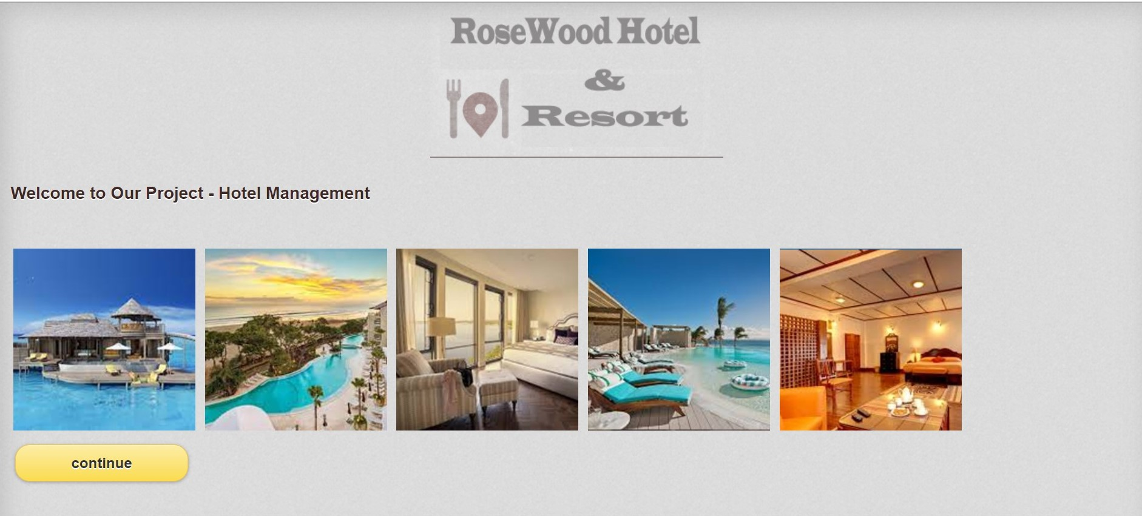
Welcome Page
Firstly , When we open our website the welcome page is opened . In this page we add different pictures of our hotel and also add its logo image with the help of header tag . In the footer tag we add a continue button . When we click on continue button the next page is open …………………

Slide 4
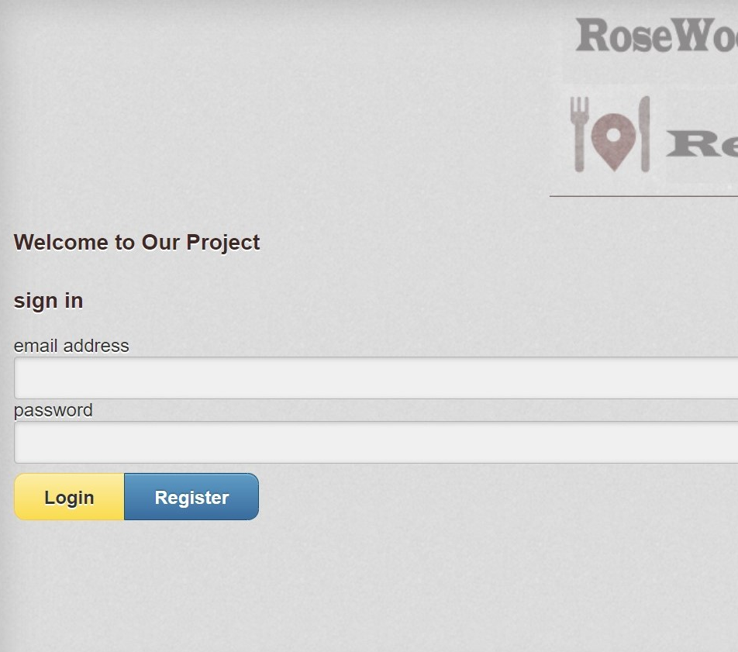

Login And Register Page
In this page , we provide sign in option and in bottom two buttons login and Register button . To register our id click on register button and fill our details in it and then click submit button . After that enter the email address and password in sign in form and click on login button and then next page is open ………..

Slide 5
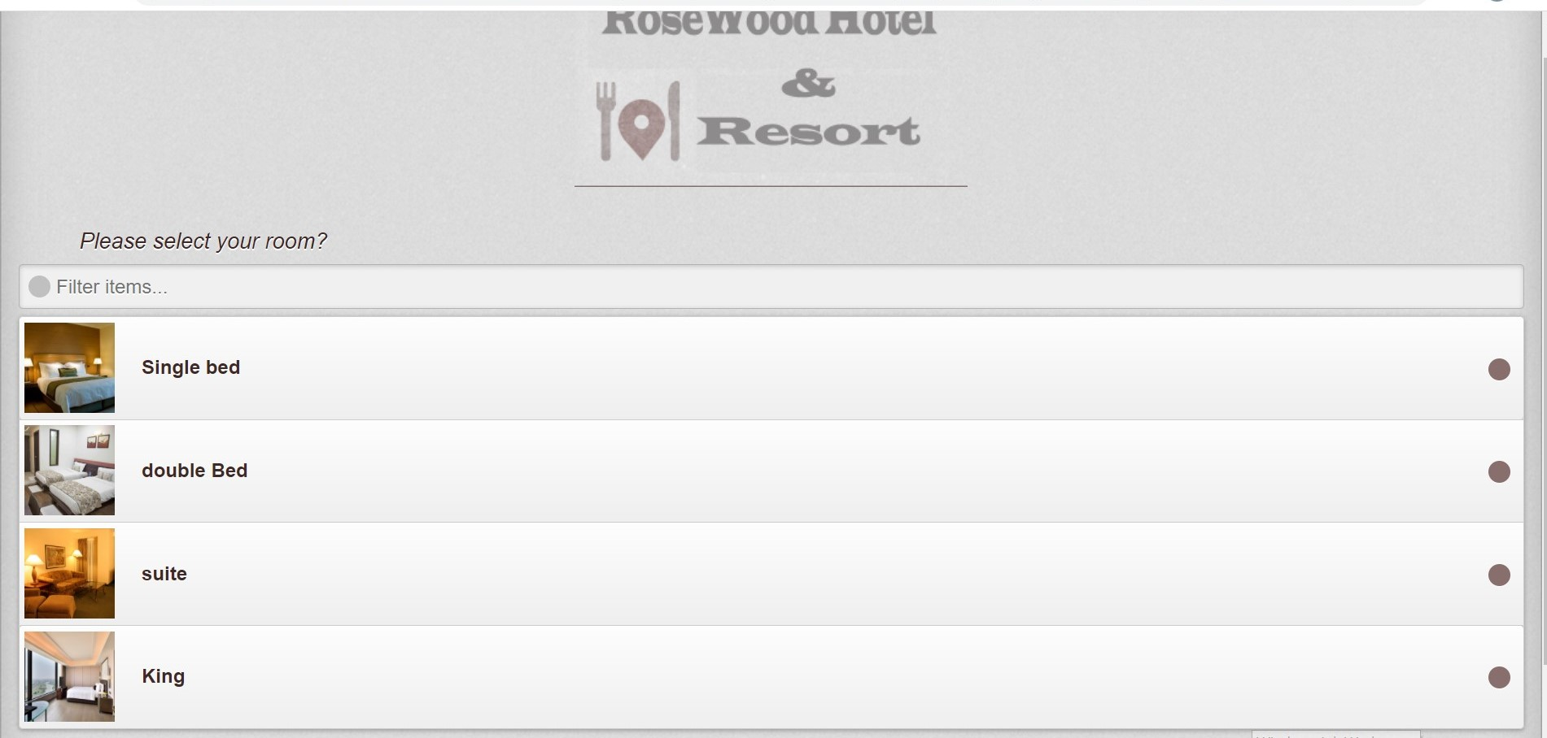
Home page
In this page , we provide the product list of our hotel . In this page we add four different type of bedrooms like single bed , double bed, suite and king bed . Moreover , in the bottom of this page we add three buttons with the name login, My cart and Profile. When we click My cart button the cart and same when we click on profile button our profile is open . Furthermore , when we click on any room column the room detail form is open………..

Slide 6
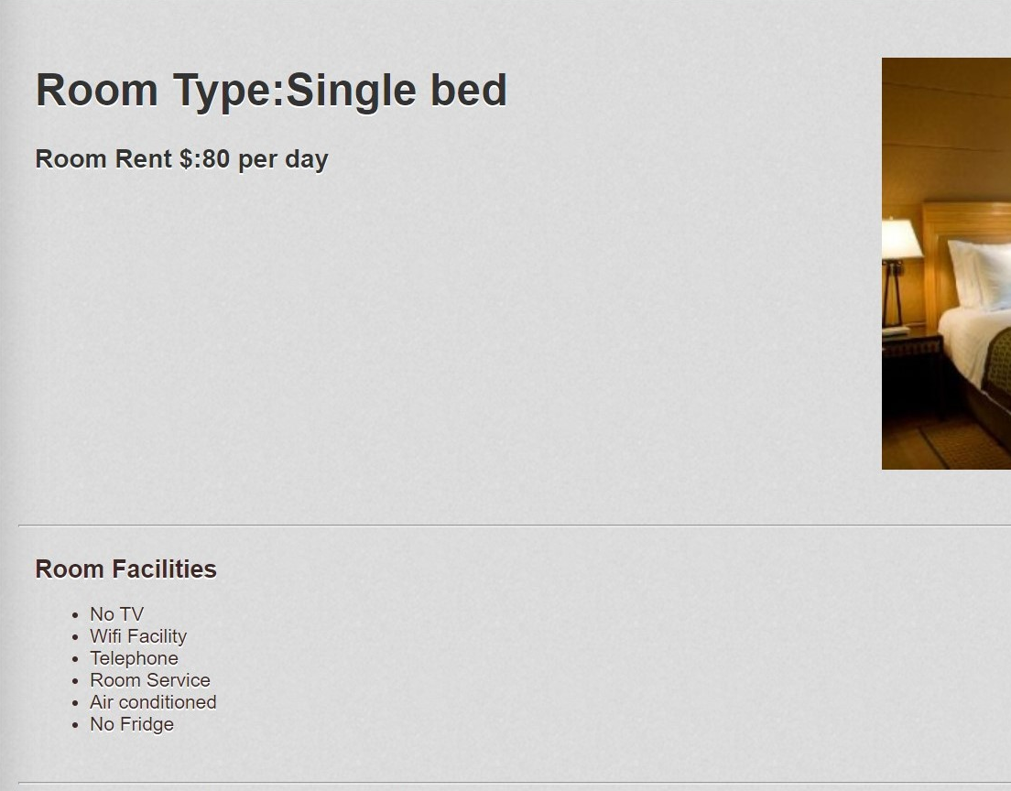
Product Details
In this page , we entered the room facilities with their prices and in bottom of this page add to cart option is present when we click on it the product is added to my cart page. So we add the rooms which we need by reading their facilities ….

Slide 7
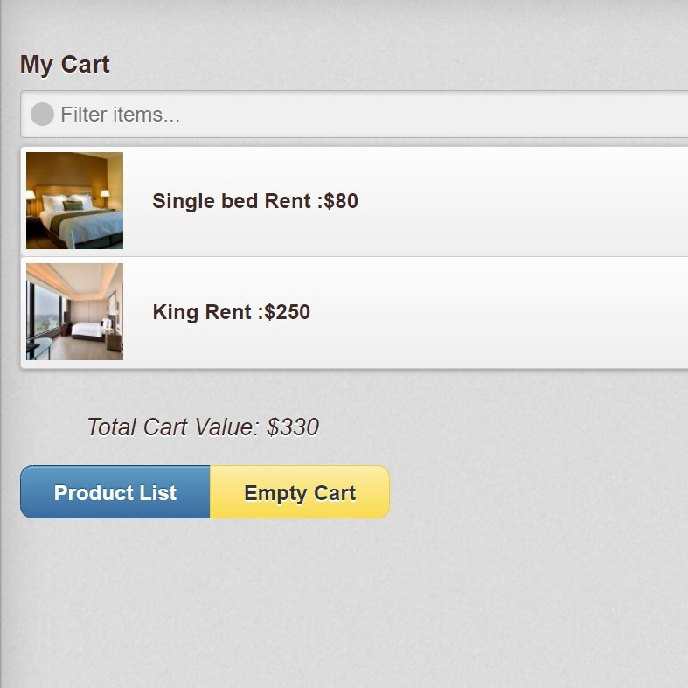
My cart
After adding the products to my cart the products are shown in my cart page and this page also add the amount of all products and show the total value . In the bottom of this page the empty cart button is present when we click on this button the all data cleared from cart………

Slide 8
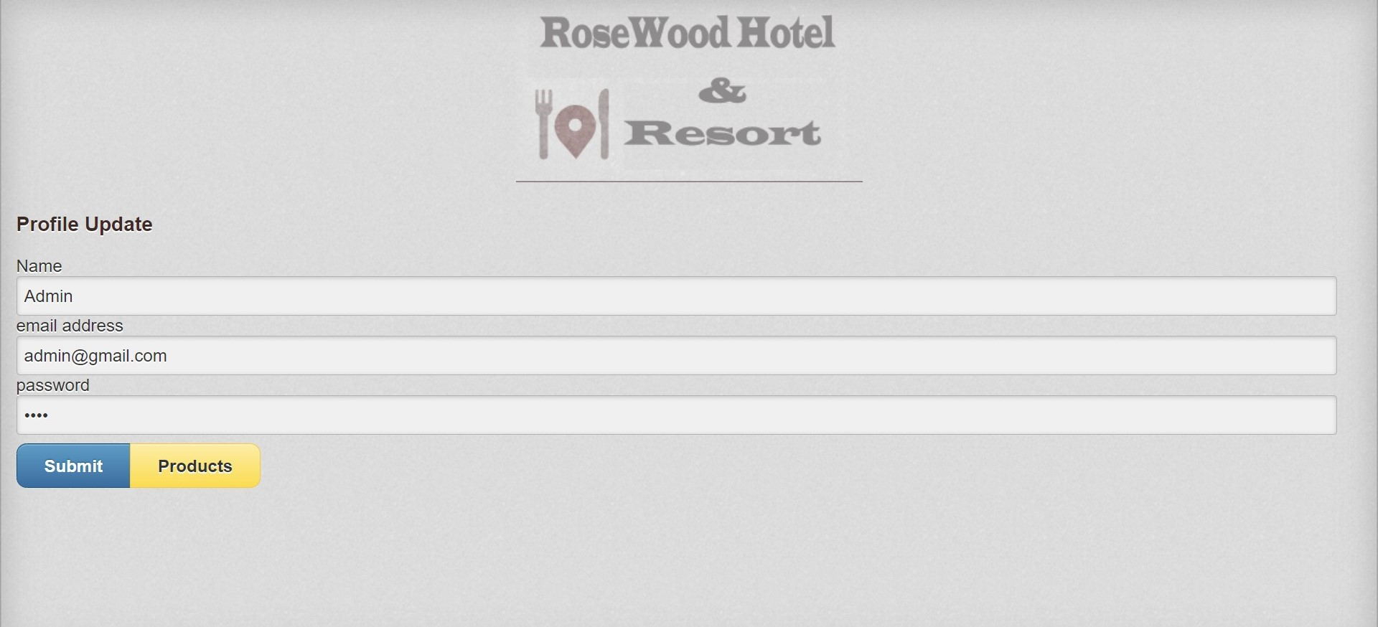
Profile update page
In this page, we add three columns first column is for Name second is for email address and third is for password and after entering the values in these columns and then click on submit button the profile is updated……

Slide 9

Thank you
Group 3 we all group members work hard to make this website hope u like it

